Slide 1
Climate Change
Examining Ecological Health, Conflict, and the Overall Environmental Vulnerability Index (EVI) worldwide, to identify nations most vulnerable to climate change.
DATS 6103 - Individual Project 2 - Nelson Foster

Slide 2
Introduction to the Research
Environmental Vulnerability Index
Ecological Footprint of Countries’ Consumption, per capita

Slide 3
Environmental Vulnerability Index (EVI)
Formulated by the National Aeronautic & Space Administration’s (NASA) Socioeconomic Data & Applications Center (SEDAC), Columbia University, 2004
Per SEDAC, the EVI is “An aggregation of 50 indicators and subindexes which attempt to estimate nation’s relative vulnerabilty to future ecological or environmental shocks”
Overall EVI Scale is as follows:
Extremely vulnerable: 365+
Highly vulnerable: 315-364
Vulnerable: 265-314
At risk: 215-264
Resilient :<264

Slide 4
EVI (Cont’d)
Dataset included raw numbers, such as Population Density, Coastal Population Density, High Winds, High Sea Temperatures, etc., and corresponding sub-indexes, normalized on a 1-7 scale, with 1 being good; 7 being bad.
In addition to the individual sub indexes and overall EVI aggregate, there were two sub-indexes which were smaller aggregations of key individual indicators:
Climate Change Sub-Index
Biodiversity Sub –Index

Slide 5
EVI (cont’d): Climate Change Sub-Index
Per the SEDAC EVI Data Dictionary, “The Climate Change Sub-Index of the EVI represents an unweighted average of the scores for the following variables:”
WINDEVI: High Winds
DRYEVI: Dry periods
WETEVI: Wet periods
HOTEVI: Hot Periods
SSTEVI, Sea Temperatures
LANDEVI, Land Area
RELIEFEVI: Vertical Relief
LOWEVI: Lowlands
VEGEVI: Loss of Natural Vegetation Cover
WATEREVI: Renewable Water
POPDNEVI: Population Density
CSTPOPEVI: Human Populations (in coastal lands)
Notes:
WINDEVI: High Winds (Scaled), Values are total knots of excess wind per year.
DRYEVI: Dry periods (Scaled), Millimetres of rainfall deficit (negative value). Total rainfall deficit in mm over the past 5 years, averaged over all stations and months for which there were data. Final values expressed as annual figures.
WETEVI: Wet periods (scaled), Millimetres of excess rainfall. Total excess rainfall in mm over the past 5 years, averaged over all stations and months for which there were data. In their final form results are expressed as annual excess.
HOTEVI: Hot Periods (scaled), Total degrees (Farenheit) of excess heat per year. Annual averages over the past 5 years of summed deviations of daily maximum temperatures that are more than 9F higher than the 30 year monthly mean maximum temperatures, calculated for each climate station in a country and then averaged over all climate stations.
SSTEVI, Sea Temperatures (scaled), Absolute values of temperature anomalies in relation to the 30 year monthly (1961-1990) averages in degrees C
LANDEVI, Land Area (scaled), Total land area (accumulated across islands, if present in square kilometers)
DISPEVI, Country Dispersion (scaled): Total length of land and sea borders (km) / land area of country (accumulated across islands, if present) (1000 sq km).
RELIEFEVI: Vertical Relief (scaled), Altitude range (highest point subtracted from the lowest point in country)
LOWEVI: Lowlands (scaled), Percentage of total land area which is ≤50m above sea level anywhere in the country. VEGEVI: Loss of natural vegetation cover (Scaled), Percent change in natural forest cover over last 5 years.
WATEREVI: Renewable Water (scaled), Water use as a percent of total renewable water (note this does not imply that any water used actually comes from renewable sources).”
POPDNEVI: Population Density (Scaled), Total human population/sq km. CSTPOPEVI: Human Populations (Scaled), Population living with 100 km of a coast divided by the area of coastal lands (sq km)."

Slide 6
EVI (cont’d):Biodiversity Sub-Index
Per the SEDAC EVI Data Dictionary, “Biodiversity Sub-Index of the EVI represents an unweighted average of the scores for the following variables:”
SSTEVI: Sea Temperatures
LANDEVI: Land Area
DISPEVI: Country Dispersion
ISOLEVI: Geographic Isolation
RELIEFEVI: Vertical Relief
LOWEVI: Lowlands
BORDEVI, Shard Borders
IMBALEVI: Ecosystem Imbalance
OPENEVI Environmental Openness
MIGEVI: Migratory Species
ENDEMEVI: Endemic Species
ENDANGEVI: Endangered Species
EXTINCTEVI: Extinctions
VEGEVI: Natural Vegetation Cover Remaining
VEGLOEVI: Loss of natural vegetation cover
FRAGEVI: Fragmented Habitats
RESRVEVI: Terrestrial Reserves
MPAEVI: Marine Reserves
Notes:
SSTEVI: Sea Temperatures (scaled), Absolute values of temperature anomalies in relation to the 30 year monthly (1961-1990) averages in degrees C LANDEVI: Land Area (scaled), Total land area (accumulated across islands, if present in square kilometers)
DISPEVI: Country Dispersion (scaled): Total length of land and sea borders (km) / land area of country (accumulated across islands, if present) (1000 sq km).
ISOLEVI: Geographic Isolation (scaled), Distance to nearest continent (in km) RELIEFEVI: Vertical Relief (scaled), Altitude range (highest point subtracted from the lowest point in country)
LOWEVI: Lowlands (scaled), Percentage of total land area which is ≤50m above sea level anywhere in the country.
BORDEVI, Shard Borders (scaled, Number of borders shared with other countries, regardless of whether they are on land or in the sea. IMBALEVI: Ecosystem Imbalance (scaled), + or - change in trophic level calculated by weighting each trophic level present in the national catch by the tonnes reported.
OPENEVI Environmental Openness (scaled), Freight density as X = thousands of dollars of freight moved into the country per sq km of land MIGEVI: Migratory Species (scaled), Density of migratory species expressed as number of species per 1000 sq
km land area under various categories of GROMS migrants.
ENDEMEVI: Endemic Species (Scaled) Species per million km2, Number of known species that migrate outside the territorial area at any time during their life spans (include land and aquatic species) / area of land. INTROEVI: Introductions(scaled), Number of species introduced per 1000 sq km of land area.
ENDANGEVI: Endangered Species (Scaled), Density of endangered species expressed as number of species per 1000 sq km land area categorised by IUCN as either critically endangered, endangered or vulnerable
EXTINCTEVI: Extinctions(Scaled), number of known extinct species per 1000 sq km land area.
VEGEVI: Natural Vegetation Cover Remaining (Scaled), Percentage of original (and regrowth) vegetation cover remaining.
VEGLOEVI: Loss of natural vegetation cover (Scaled), Percent change in natural forest cover over last 5 years.
FRAGEVI: Fragmented Habitats (Scaled), 1. Total length of all roads in a country (km) / land area (sq km) 2. Cumulative area of all fragments of natural cover greater than 1,000 ha in the country as a percent of total land area.
RESRVEVI: Terrestrial Reserves (Scaled), Percent of the total land area set aside as reserves. MPAEVI: Marine Reserves (Scaled), Percent of the shelf area set aside as marine reserves.”

Slide 7
Conflict & Conflict EVI
Human conflict: measured in human conflict years
As ecological issues and resource scarcity tend to increase the tendency for human conflict, Conflict EVI was evaluated alongside the other variables.

Slide 8
Ecological Footprint of Countries (EFC), 2004
Developed by the Global Footprint Network
Per the Global Footprint Network, the Ecological Footprint is “A measure of how much area of biologically productive land and water an individual, population or activity requires to produce all the resources it consumes and to absorb the waste it generates, using prevailing technology and resource management practices”
Data is scaled to per-capita footprint
To normalize against the EVI Data, dataset limited to 2004 observations

Slide 9
EFC (Cont’d)
EFC is evaluated by the following variables:
Carbon: Carbon Dioxide Emissions Fishing Grounds: Fisheries for human consumption
Cropland: Land used for agricultural purposes
Built -Up Land: Urban areas Forest Products: Forest land used for industry
Grazing Land: Amount of grazing land
Total: Total Ecological Footprint
Total EFC and Carbon are the focus of this analysis, compared against EVI

Slide 10
EVI and EFC: Findings

Slide 11
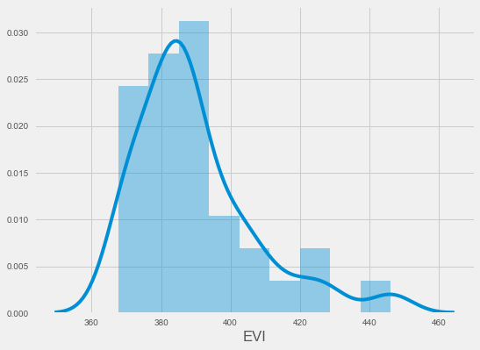
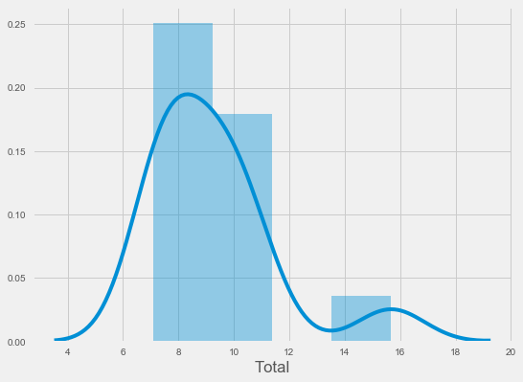
Distributions
Overall EVI: Most Vulnerable Nations
Overall EFC: Nations w/Largest Footprint

Slide 12
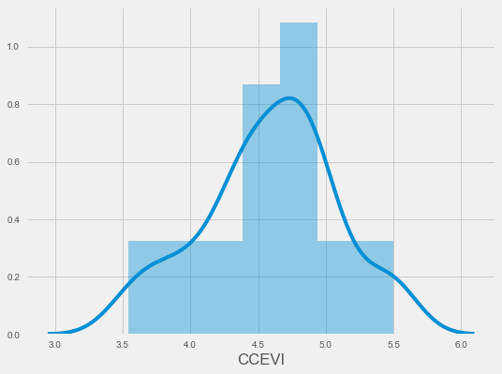
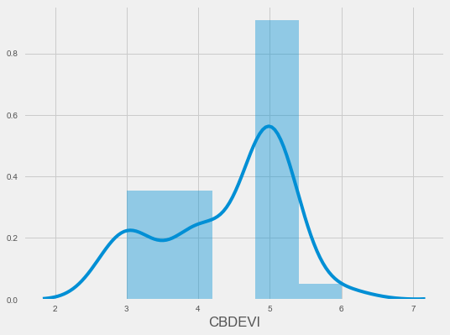
Distributions (cont’d)
Climate Change Sub-Index
Biodiversity Sub-Index

Slide 13
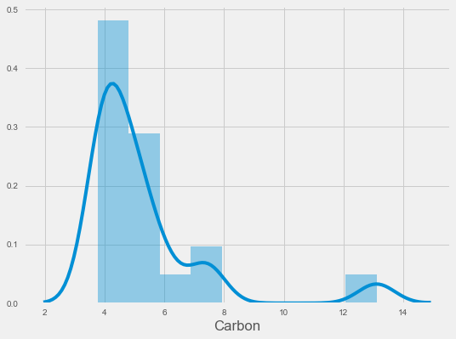
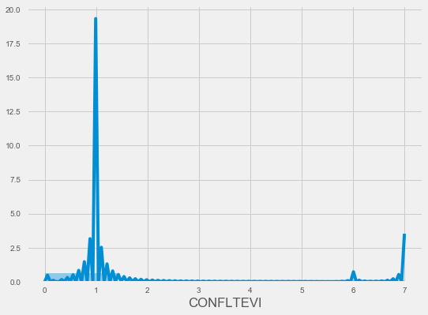
Distributions (Cont’d)
Carbon EFC
Conflict Years Sub-Index

Slide 14
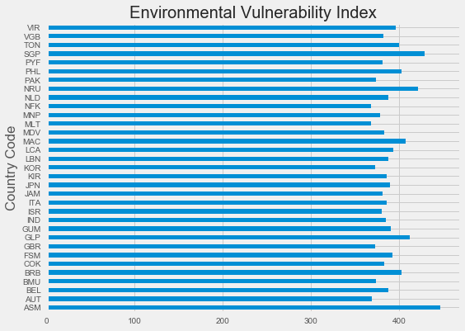
EVI among Most Vulnerable Nations

Slide 15
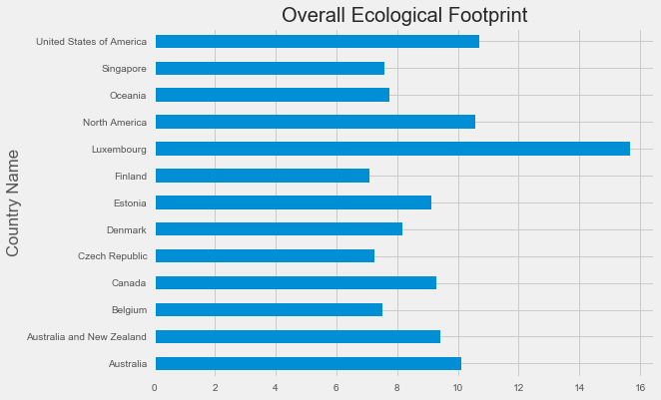
Overall Ecological Footprint (per capita)

Slide 16
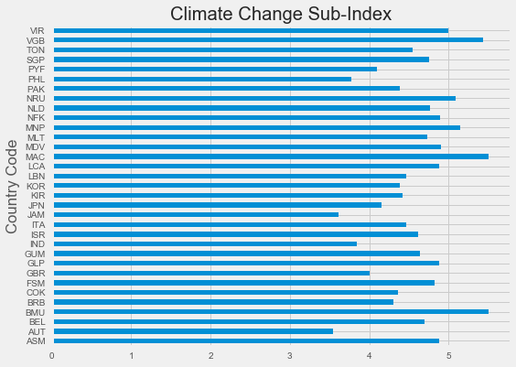
Most Vulnerable Nations – Climate Change

Slide 17
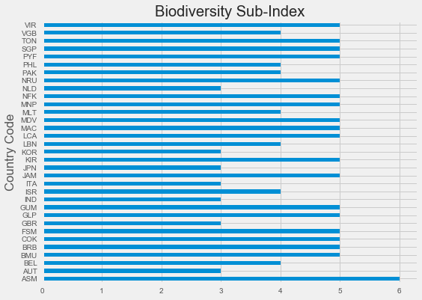
Most Vulnerable Nations: Biodiversity

Slide 18
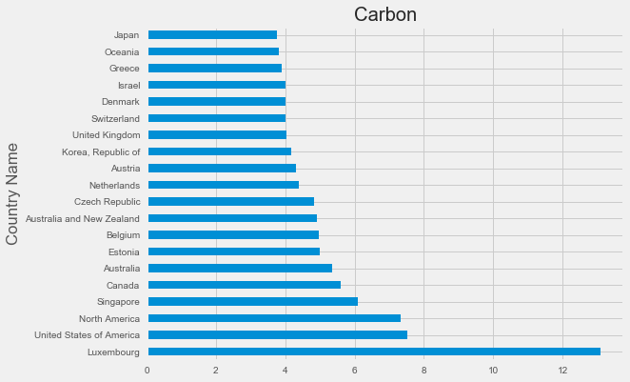
Largest Carbon Footprint

Slide 19
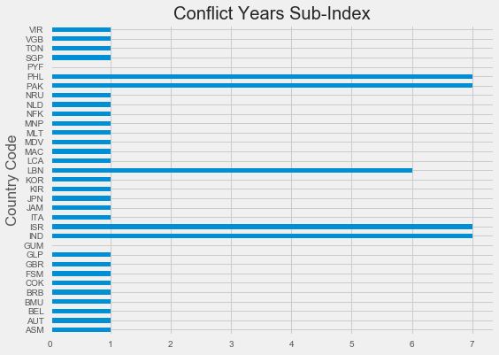
Conflict

Slide 20
Conclusions
Low-Lying nations, nations with large populations in coastal zones, and island nations are more susceptible to climate-change and biodiversity-related ecological risk
Conflict serves to both result from and exacerbate the risk
Nations with the largest per-capita ecological footprint have the most negative effect on the overall global ecology and serve to increase the risk to most vulnerable nations.

Slide 21
References
Environmental Vulnerability Index (EVI), 2004 Release (1973 – 2003), Compendium of Environmental Sustainability Indicators, Socioeconomic Data & Applications Center, Earth Observing System Data and Information System (EOSDIS), National Aeronautical & Space Administration (NASA), hosted by Columbia University. Retrieved from http://sedac.ciesin.columbia.edu/data/set/cesic-environmental-vulnerability-index-2004/data-download
Socioeconomic Data and Applications Center (SEDAC), 2007. Compendium of Environmental Sustainability Indicator Collections Version 1.1 – Data Dictionary Center for International Earth Science Information Network (CIESIN).Columbia University. Retrieved from http://sedac.ciesin.columbia.edu/data/set/cesic-environmental-vulnerability-index-2004/data-download
Ecological Footprint of Countries (EFC), 2004, Ecological Footprint Explorer, Global Footprint Network. Retrieved From http://data.footprintnetwork.org/compareCountries.html?yr=2004&type=EFCpc&cn=all

Slide 22
Thank you for a great semester!

